Slide 1

FastGAN: Faster and Stabilized GAN
Mauro Ficorella 1941639 | Martina Turbessi 1944497 | Valentina Sisti 1952657

Slide 2
Introduction
Our work is based on the paper “Towards Faster And Stabilized Gan Training For High-fidelity Few-shot Image Synthesis”.
OBJECTIVES:
Allow users with limited computing budget and resources to train a GAN;
Eliminate the requirement of a big dataset for training;
Allow to train models from scratch in order to avoid biases typic of the pre-trained models and to let people use their own set of interest images;
Few hours required for training time;

Slide 3
implementation
HARDWARE ADOPTED:
NVIDIA GeForce RTX 2070 SUPER (8GB of VRAM)
NVIDIA GeForce GTX 1050-Ti (4GB of VRAM)
TECHNOLOGIES ADOPTED:
Python
TensoFlow
NVIDIA CUDA
NVIDIA cuDNN

Slide 4
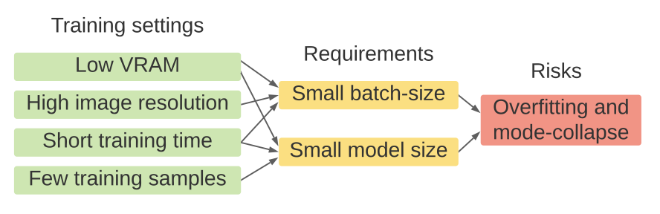
Gan’s Problems
Accelerate training: this problem has been approached from various perspectives, but this brought only very limited improvements in training speed, while not enhancing quality within the shortened training time;
High resolution training: this made GAN much harder to converge. There were some approaches trying to solve this problem, but they led to a slightly greater computational cost, consuming more GPU memory and requiring more training time;
Stabilize training: mode-collapse on the generator is a big challenge when training GANs, given fewer training samples and lower computational power and budgets (smaller batch-size). There were approaches that tried to solve this problem, but they worked only on low resolution images with unlimited computing resources.

Slide 5
FastGAN Solution
FastGAN reaches the objectives based on the following two techniques:
Skip-Layer channel-wise Excitation module: revises channel responses on high-scale feature-maps using low-scale activations and allows to reach a faster training using a more robust gradient flow throughout the model weights;
Self-supervised discriminator D trained as a feature-encoder with an extra decoder: this discriminator is forced to learn a feature-map that covers more regions from an image in input; in this way it gives richer signals in order to train G. It has been shown that auto-encoding is the best self-supervision strategy for D.

Slide 6
In order to optimize GANs with respect to the SOTA models, in FastGAN is adopted a lightweight model, using a single convolutional layer on each resolution in the generator.
On the high resolutions in both generator and discriminator, only three channels for the convolutional layers are applied in input and output. This structure helps making FastGAN faster to train, remaining, at the same time, strong on small datasets.

Slide 7
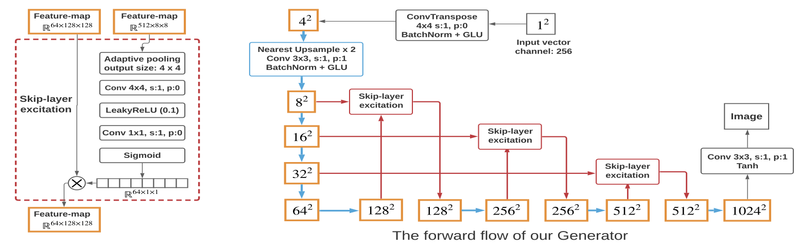
Method: Generator
Generator’s adversarial loss function:
$$ℒ_{G}=−𝔼_{z\sim 𝒩}[D(G\left(z\right))]$$

Slide 8
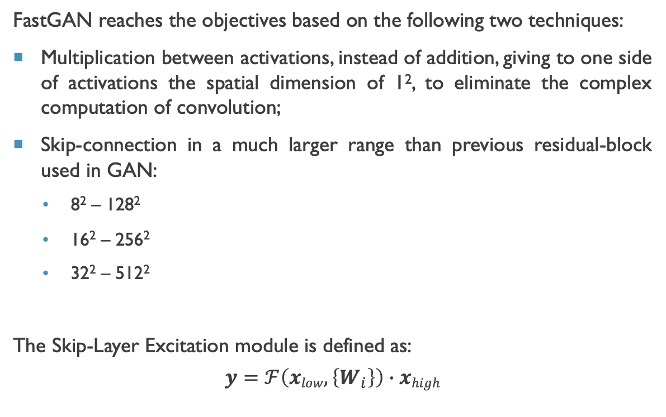
Method: Skip-Layer Channel-Wise Excitation
FastGAN reaches the objectives based on the following two techniques:
Multiplication between activations, instead of addition, giving to one side of activations the spatial dimension of 1², to eliminate the complex computation of convolution;
Skip-connection in a much larger range than previous residual-block used in GAN:
8² – 128²
16² – 256²
32² – 512²
The Skip-Layer Excitation module is defined as:
$$y=ℱ\left(xlow, \left\{W_{i}\right\}\right)∙xhigh$$

Slide 9
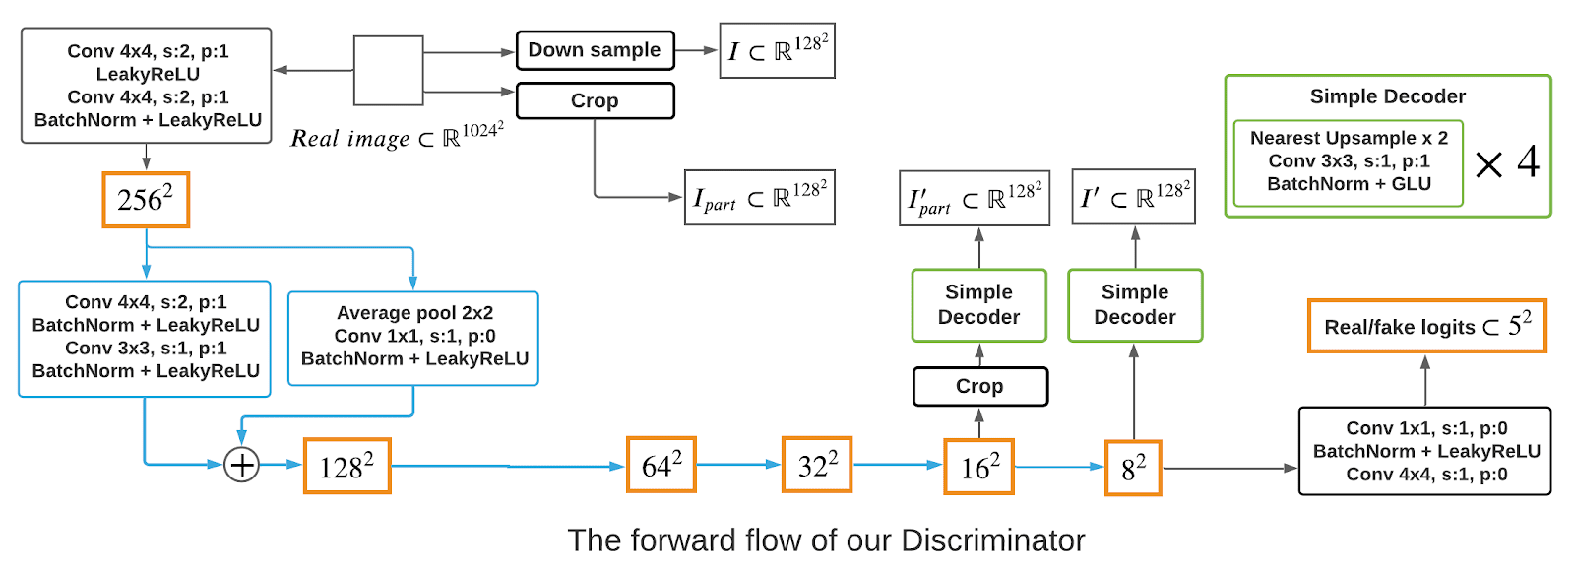
Method: Self-Supervised Discriminator
Discriminator’s adversarial loss function:
$$ℒ_{D}=−𝔼_{z\sim Ireal}\left[min\left(0, −1+D\left(x\right)\right)\right]−𝔼_{\hat{x}\sim G\left(z\right)}\left[min\left(0, −1−D\left(\hat{x}\right)\right)\right]+ℒ_{recons}$$

Slide 10
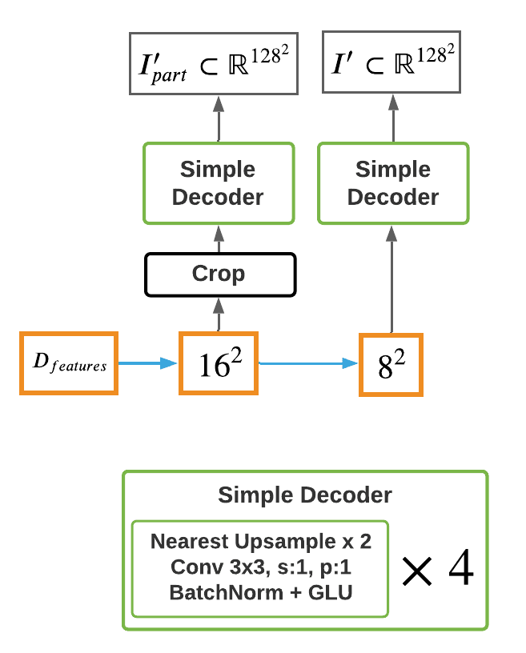
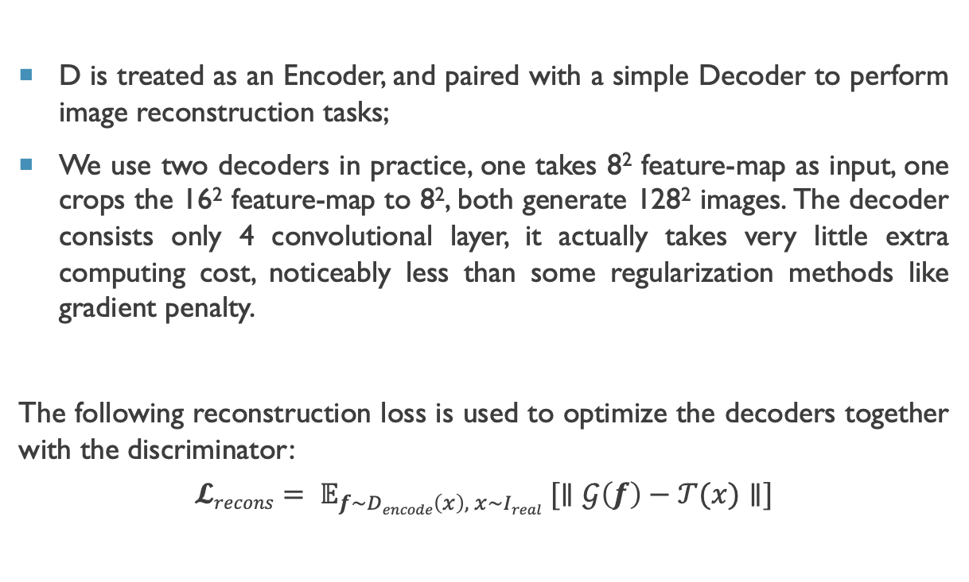
Method: Self-Supervised Discriminator
D is treated as an Encoder, and paired with a simple Decoder to perform image reconstruction tasks;
We use two decoders in practice, one takes 8² feature-map as input, one crops the 16² feature-map to 8², both generate 128² images. The decoder consists only 4 convolutional layer, it actually takes very little extra computing cost, noticeably less than some regularization methods like gradient penalty.
The following reconstruction loss is used to optimize the decoders together with the discriminator:
$$𝓛recons= 𝔼_{f\sim Dencode\left(x\right), x\sim Ireal} [∥𝒢\left(f\right)−𝒯(x)∥]$$

Slide 11
other methods
The model is built starting from a baseline model that is made of the following methods:
Batch-normalization;
Differentiable-augmentation;
ADAM optimization on G;
GLU instead of ReLU in G .

Slide 12
Metric: FID
The metric used in our work is FID:
Calculates the distance between feature vectors calculated for real and generated images;
Summarizes how similar the two groups are in terms of statistics on computer vision features of the raw images;
Lower scores indicate that the two groups of images are more similar.

Slide 13
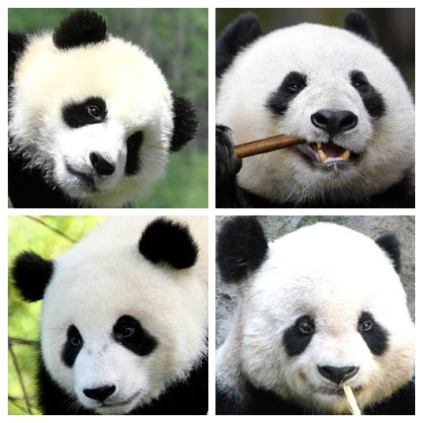
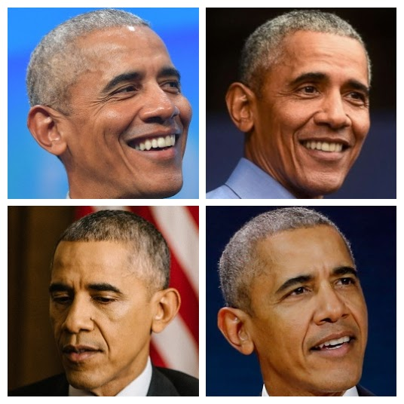
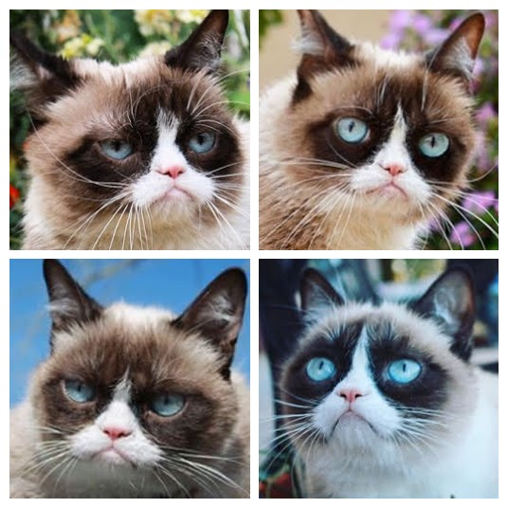
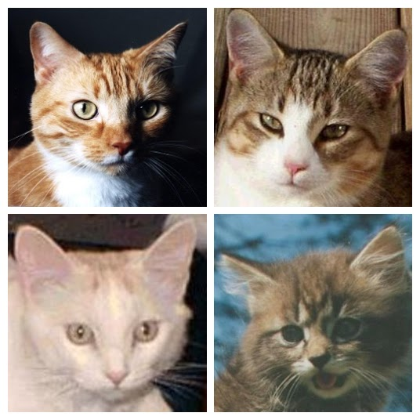
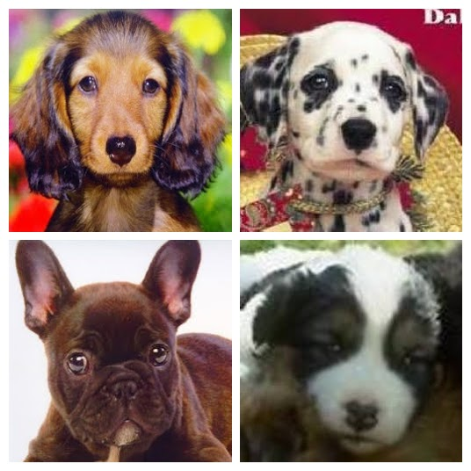
dataset
We used the following datasets of resolution 256 × 256:
Panda
Obama
Animal-Face Dog
Animal-Face Cat
Grumpy-cat

Slide 14
Requisiti tecnici
Rete
Satellite
Collegamento

Slide 15

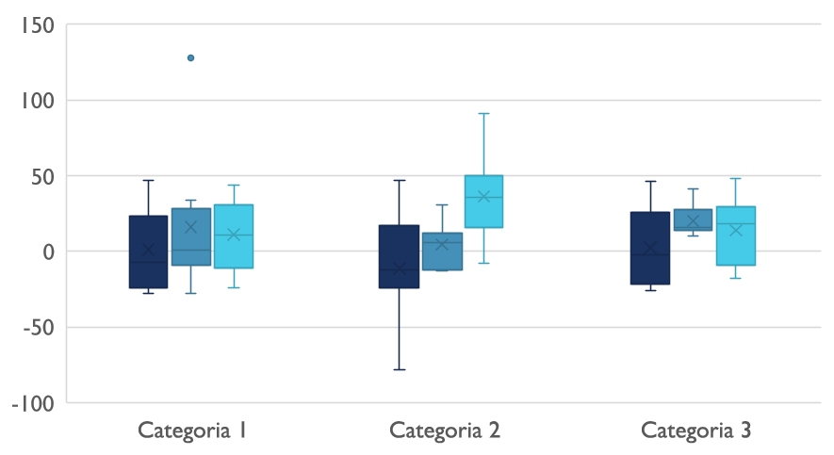
Panorama competitivo

Slide 16

Comunicazioni digitali
Nuvola
Locale
Ibrido

Slide 17

Grazie
prova@example.com

